Slide 1
Strategize Bridge Maintenance Effectively
Tina Feng (shutingf)
Monika Sembiring (msembiri)
Notes:
Hello, we are team 8 and we are happy to walk you through our project 2: strategize bridge maintenance effectively
10min in total
Executive summary: 1 min [TBD after case studies] [Monika + Tina]
Problem background & motivation: 30s[Tina]
Goals: 1min [Tina]
Dataset: 30s [Tina]
Methodology: 2.5 min [Monika]
Analysis & Results: 1.5 min [Tina]
Case studies + recommendations: 3 min [TBD after final model results] [Monika + Tina]
12/9 9pm: discuss case studies + recommendations after final model results come out
12/10 5pm: slides ready+record presentation

Slide 2
Agenda
Executive Summary
Background & Motivation
Goals
Dataset
Methodology
Analysis & Results
Case Studies & Recommendations
Notes:
Here’s the agenda for our presentation today

Slide 3
Executive Summary
Best model for bridge condition classification is Random Forest, with an accuracy of 77.8% and a recall rate of 64.1%.
The most essential features in determining bridges' condition are Substructure Condition, Superstructure Condition, Reconstruction Age, Age, Deck Condition, and Rehab/Replace Eligibility.
On top of the predicted condition result, maintenance prioritization will be evaluated with the availability of alternative routes, bridge size, traffic amount, and estimated maintenance cost.
Notes:
And here is a synopsis of the major findings of our analysis, including the best classification model, most import features in determining bridges’ condition, and a bridge maintenance prioritization framework with case studies.

Slide 4
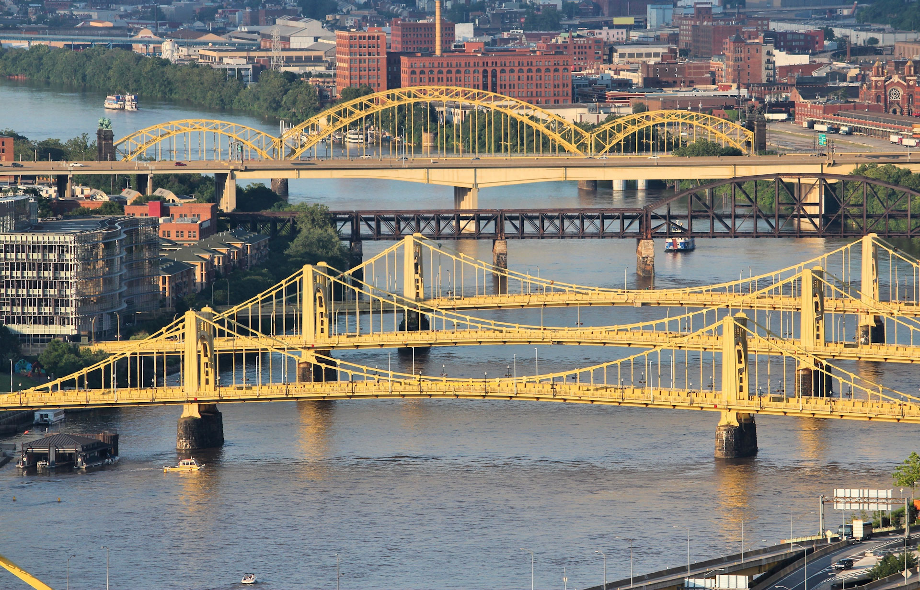
Background and Motivation
Last January, Fern Hollow Bridge collapsed on the day President Biden visited Pittsburgh, the City of Bridges.
Although no one died, we wonder: What are the factors associated with the risk level/condition of a bridge? The answer can help prevent potential bridge collapses in the future, thus preparing for better maintenance for the bridge and providing people with a safer living environment.
Notes:
So, why are we interested in this bridge condition and maintenance topic? Last January, Fern Hollow Bridge collapsed on the day President Biden visited Pittsburgh, the City of Bridges.
Although no one died, we wonder: What are the factors associated with the risk level/condition of a bridge? The answer can help prevent potential bridge collapses in the future, thus preparing for better maintenance for the bridge and providing people with a safer living environment.
22s

Slide 5
Goals
Help government prioritize bridge inspection and maintenance for bridges with poor conditions before hand; encourage better preservation to maintain the sustainability of bridges in excellent condition → Classification Task
Recommend some bridges regarding maintenance efforts and costs on top of bridge conditions and other attributes to help government strategically allocate the bridge maintenance budget → Case Studies
Notes:
In this project, we will analyze bridge data in Allegheny county to achieve two goals:
Predict the conditions of bridges based on the bridge attributes and factors that affect bridge conditions like traffic and number of historical crashes. With this prediction, the government can prioritize bridge inspection and maintenance for bridges with poor conditions ahead. Regarding the bridges that are still in excellent condition, the insight will encourage better preservation to maintain the sustainability of the bridges.
We would recommend some bridges to focus on regarding maintenance effort after combining the bridges condition and other considerations such as location, daily utilization, and maintenance cost. With this list, government can strategically allocate the bridge maintenance budget.
47s

Slide 6
Dataset
Bridge condition dataset
Source: Pennsylvania Department of Transportation (PennDOT) website
1576 rows & 25 columns
Latest condition and attribute information about Allegheny County’s bridges
Crash dataset
Source: The Western Pennsylvania Regional Data Center (WPRDC) website
216624 rows & 190 columns
Cumulative crash data for Allegheny County from 2004 to 2020; interested in the crashes related to “hit bridge”
A more comprehensive bridge dataset
Source: ArcGIS Hub website: Pennsylvania Bridges
1582 rows & 173 columns
More comprehensive data about bridges in Allegheny county
Notes:
Our project uses the combination of three datasets. Our main dataset is the bridge condition dataset which contains the latest condition and attribute information about Allegheny County’s bridges.
We also used a crash dataset which provides cumulative crash data for Allegheny County from 2004 to 2020. Our main interest in this dataset is the Hit_Bridge column to tell whether the crash hit the bridge, which can be a feature that affect bridge conditions.
Lastly, we included a more comprehensive bridge dataset which include more information about bridges in Allegheny county like inspection, reconstruction information and improvement costs.
We would merge all three datasets for our analysis.
40s

Slide 7
Methodology
Background studies
Features selection
Data preprocessing
Model selection
Case Studies
Notes:
We implement the analysis with these five steps (4s)
NEXT

Slide 8
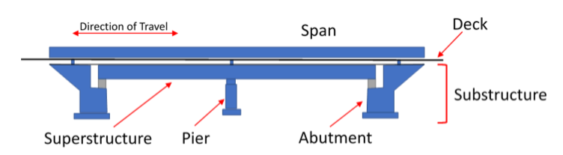
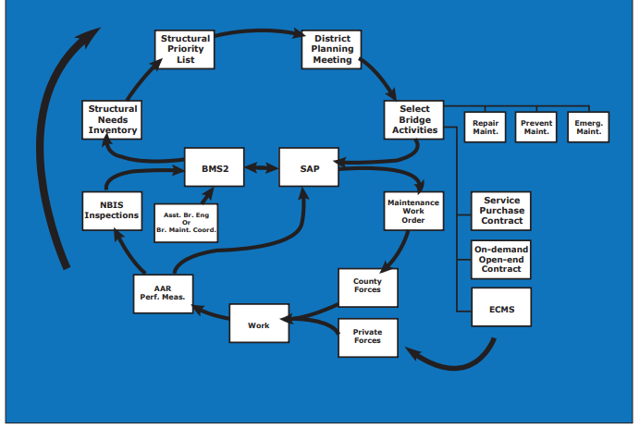
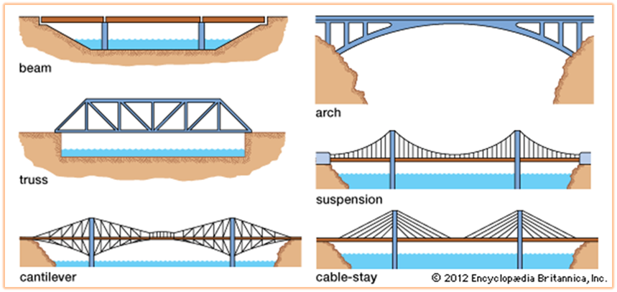
Methodology
Background studies
Features selection
Data preprocessing
Model selection
Case Studies
Source: PennDOT
Notes:
Before jumping to the code and machine learning, we did background studies to understand the problem domain better.
CLICK
We studied different components of a bridge,
CLICK
different types and materials,
CLICK
and the bridge maintenance process in Pennsylvania.
CLICK
Our analysis, in particular, will provide added value to the Select Bridge Activities and Maintenance Work Order.
(25s)
NEXT

Slide 9
Methodology
Background studies
Features selection
Data preprocessing
Model selection
Case Studies
Bridge condition dataset
Selected 15 out of 25 columns
Drop the columns that is not related to bridge condition and has too many missing values
Crash dataset
Goal: finding the number of times a crash happened on a specific bridge
Selected 3 out of 190 columns: latitude, longitude, and flag whether the crash hit the bridge or not
A more comprehensive bridge dataset
Goal: getting the latitude and longitude data to join the bridge and crash dataset
Found other features that affect bridge conditions, such as reconstruction year and rehabilitation/replacement eligibility
Selected 10 out of 173 columns
Notes:
We manually did the feature selection. We didn't use any machine learning method for feature selection because we will use the other two datasets for specific goals.
As you can see, we selected 15 out of 25 columns from the main dataset and got rid of the columns that were not relevant.
For the crash dataset, since our goal was to find the number of crashes that happened on a specific bridge, we only used three columns out of 190.
Lastly, for the other bridge dataset, our goal is to get the latitude and longitude to join the first and second datasets. We found some additional features that might affect the analysis; therefore, we only used 10 out of 173 columns.
(45s)

Slide 10
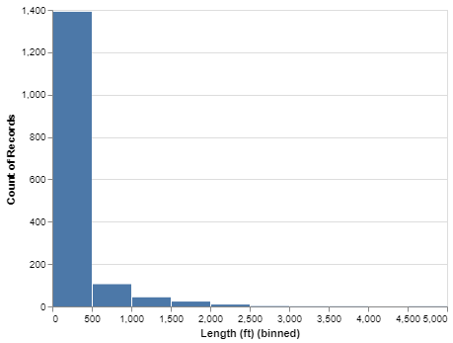
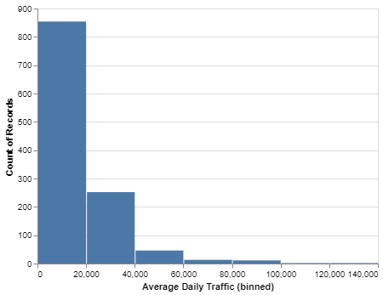
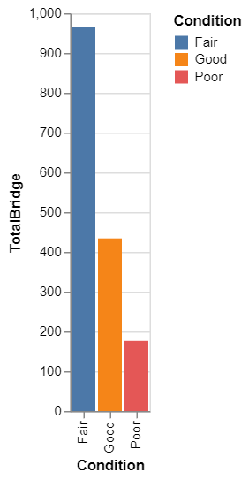
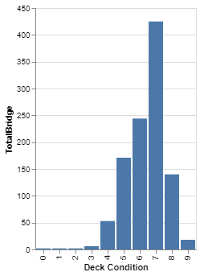
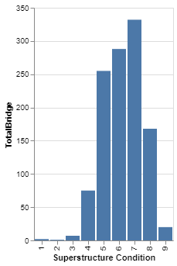
Methodology
Background studies
Features selection
Data preprocessing
Model selection
Case Studies
Merge the datasets.
Fix the data:
Parse condition rating numbers
Calculate bridge age
Calculate bridge reconstruction age
Handle the rehab/replace categories
Create dummies for categorical variables.
Notes:
After selecting the features, we preprocessed the data by merging them, fixing some of the data with these 5 steps, and create dummies for categorical variables. We also did some EDA to see the distribution of the data.
CLICK
As you can see all the numerical columns is right skewed,
CLICK
while the categorical variables is shaped like normal distributions. Knowing this we use to decide to use StandardScaler to standardize the data.
CLICK
We also see that the data is imbalance in terms of target variables. Therefore when building the model, we did random sampling.
(38s)
NEXT

Slide 11
Methodology
Background studies
Features selection
Data preprocessing
Model selection
Case Studies
PIPELINE
Sampling with RandomOverSampler.
Imputation:
Most frequent for categorical variables.
Compared Simple Imputer, KNN Imputer, and Iterative Imputer and chose Iterative Imputer due to its flexibility.
Standardization with StandardScaler
TRAINING
K Nearest Neighbor
Random Forest
Gradient Boosting
Gaussian Naive BayeS
Support Vector Machines
Performance Evaluation:
Accuracy and Recall
AUC ROC curve
Notes:
After having the data ready, we spit them into train and test dataset.
CLICK
Then, we built a pipeline to do sampling, imputation, and standardization with selected method accordingly.
CLICK
Using the data resulted from the pipeline, we trained the dataset using five models and compared their performance.
NEXT
(20s)

Slide 12
Methodology
Background studies
Features selection
Data preprocessing
Model selection
Case Studies
MAINTENANCE PRIORITIZATION FRAMEWORK
The availability of alternative routes
Bridge size
Traffic amount
Estimated maintenance cost
Notes:
Lastly, after getting the prediction result using the selected model, we explore some bridges in Poor conditions. We dig deeper in terms of their location, size, traffic, maintenance cost, and availability for the alternative routes to produce a framework that can be used to prioritize bridge maintenance.
(22s)
NEXT

Slide 13
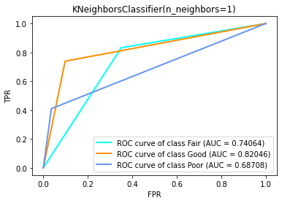
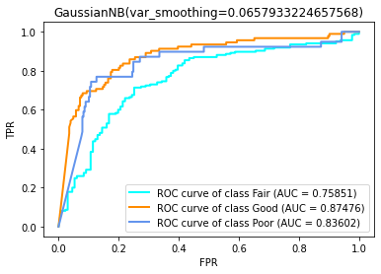
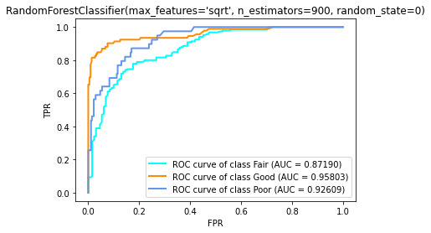
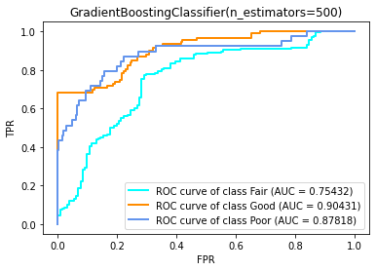
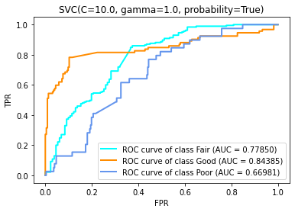
Analysis & Results
Classification Model | Accuracy | OVR AUC
K Nearest Neighbor | 0.753 | 0.749
Gaussian Naive Bayes | 0.478 | 0.823
Support Vector Machine | 0.627 | 0.764
Random Forest | 0.778 | 0.919
Gradient Boosting | 0.741 | 0.846
Notes:
As mentioned before, we trained five classification models and selected random forest as the best model given the highest accuracy of 0.778, one-over-rest AUC of 0.919, and auc for each class all over 0.85

Slide 14
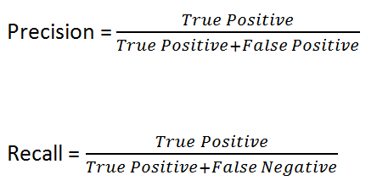
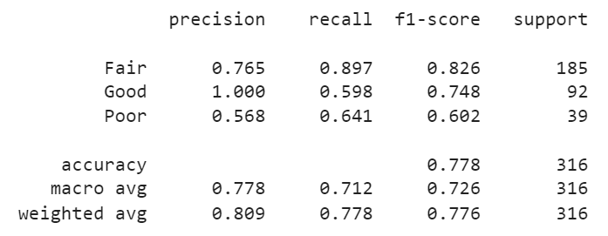
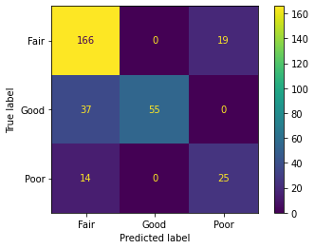
Analysis & Results
Best Model: Random Forest Classifier
Notes:
Since our goal is to predict the condition category of a given bridge and poor bridges impose more threat and danger to the public (indicative of potential collapse), false negative is more costly than false positive, and we would focus more on recall related true positive rate and also want to increase true positive and lower false negative.
In the context of bridge condition, while keeping a high accuracy, we want to have a as high recall as possible (the highest priority). However, given the limited government budget, we may also want to spend the money wisely. That is to say, on top of high accuracy and high recall, we can also try to increase precision if possible to prevent spending extra energy and money on bridges in a good shape.

Slide 15
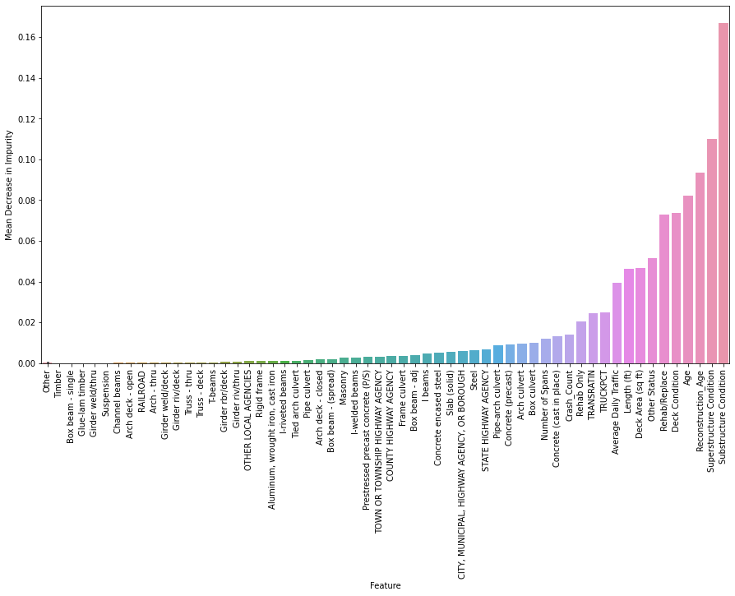
Analysis & Results
TOP 6 Most Important Features
Substructure Condition
Superstructure Condition
Reconstruction Age
Age
Deck Condition
Rehab/Replace
Notes:
According to the best model, the following TOP 6 important features are associated with bridge condition classification:
Substructure Condition
Superstructure Condition
Reconstruction Age
Age
Deck Condition
Rehab/Replace
These results make sense. For example, condition of substructure and superstructure of a bridge directly determines its "usability". Reconstruction age and age indicates who long the bridge has been put into use - older bridges would be more worn and thus subject to higher risks. Thus, government may want to focus more on these areas when trying to assess the condition of a given bridge
p7+p8+p9: 1min 40s

Slide 16
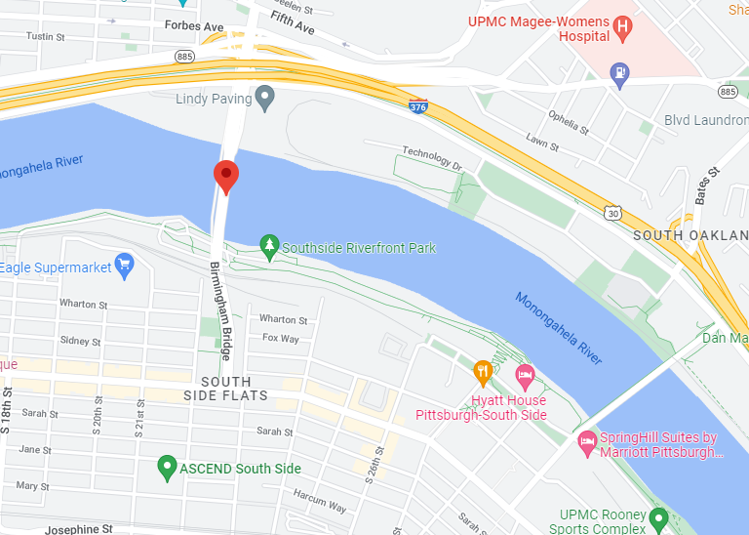
Case Studies & Recommendations
Example 1: Birmingham Bridge
Alternative routes availability Yes
Bridge size A giant bridge over the Monongahela River
Average daily traffic
5199
Estimated maintenance cost
$269k
Notes:
Although government can predict the category condition of a bridge given bridge features data using our model, deciding which bridge to prioritize for maintenance remains a problem. For example, among all the bridges that are classified as Poor, how will the government choose the ones to prioritize the maintenance on?
To answer this, we applied the framework we mentioned earlier to assess 5 bridges that are predicted as Poor.
The first bridge is Birmingham Bridge, it is a big bridge over Monongahela River with traffic and estimation cost provided. Since Birmingham bridge is near many other bridges, there are alternative routes for this bridge.

Slide 17
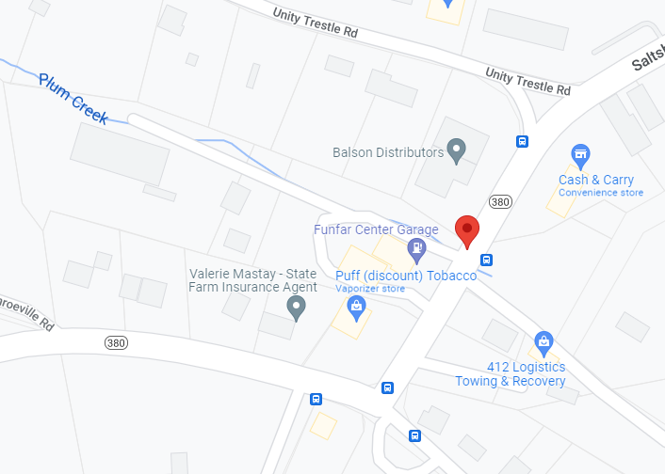
Case Studies & Recommendations
Example 2: 50' E. OF PIERSON RUN RD
Alternative routes availability Yes
Bridge size A small bridge over Plum Creek
Average daily traffic
7917
Estimated maintenance cost
$106k
Notes:
The second bridge is a small bridge over Plum Creek. You can see the traffic, estimation cost, and the alternative routes available as provided in the screen.

Slide 18
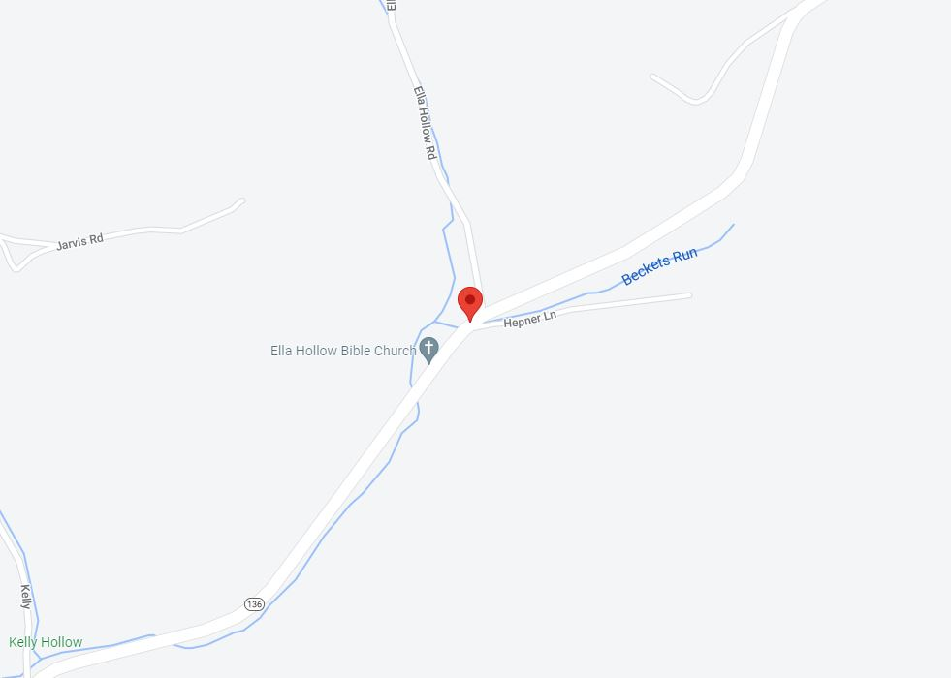
Case Studies & Recommendations
Example 3: @INTERSECT WITH SR 2013
Alternative routes availability No
Bridge size A small bridge over the Beckets Run
Average daily traffic
4283
Estimated maintenance cost
$186k
Notes:
The third bridge is a small bridge over Beckets Run. This bridge is lower in terms of daily traffic compared to other previous bridges, but the bridge is in highway Pennsylvania 136. There is no immediate alternative for this bridge. People need to go to a super far away traffic to go to their destination without this bridge.

Slide 19
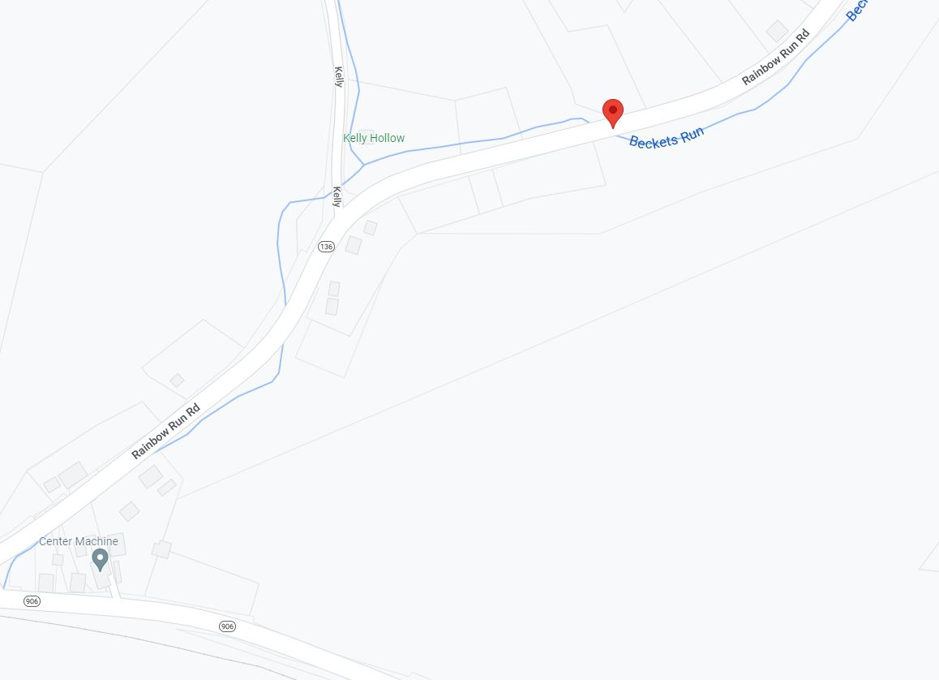
Case Studies & Recommendations
Example 4: 800FT E OF T636
Alternative routes availability No
Bridge size A small bridge over the Beckets Run
Average daily traffic
4283
Estimated maintenance cost
$113k
Notes:
The fourth bridge is near the third bridge with similar condition but lower in maintenance cost.

Slide 20
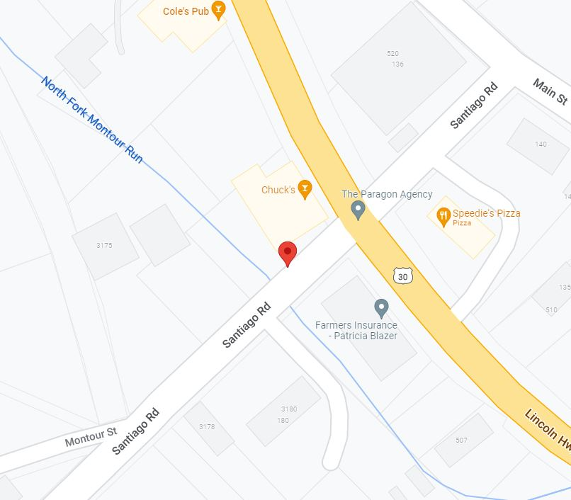
Case Studies & Recommendations
Example 5: SANTIAGO NEAR SR 0030
Alternative routes availability Yes
Bridge size A small bridge over Little Deer Creek
Average daily traffic
1723
Estimated maintenance cost
$123k
Notes:
The last bridge is a small bridge over Little Deer Creek. This bridge is lower in terms of daily traffic compared to all previous bridges and has alternative route into it.

Slide 21
Case Studies & Recommendations
FRAMEWORK
The availability of alternative routes
Bridge size
Traffic amount
Estimated maintenance cost
PRIORITIZATION
800FT E OF T636
@INTERSECT WITH SR 2013
Birmingham Bridge
50' E. OF PIERSON RUN RD
SANTIAGO NEAR SR 0030
Notes:
Considering all those four factors in these five bridges, this is our recommendation for the bridge maintenance prioritization with two bridges without any alternatives routes first, followed by the bridge with bigger size, and followed by the costly ones.

Slide 22
Thank You
Notes:
We hope this analysis useful for strategically prioritize bridge maintenance in Allegheny County. Thank you so much for listening to our presentation.

